Slide 1
Mechanics
Projectiles
Twitter: @Owen134866
www.mathsfreeresourcelibrary.com

Slide 2









Prior knowledge check
A small ball is projected vertically upwards from a point P with speed 15ms⁻¹. The ball is modelled as a particle moving freely under gravity. Find:
The maximum height of the ball
The time taken for the ball to return to P
2) Write expressions for x and y in terms of v and θ, based on the diagram below
3a) Given that $sinθ=\frac{5}{13}$ and $θ$ is acute, find $cosθ$ and $tanθ$.
b) Given that $tanθ=\frac{8}{15}$ and $θ$ is reflex, find $sinθ$ and $cosθ$.
$$cosθ=\frac{12}{13}$$
$$tanθ=\frac{5}{12}$$
$$11.5m$$
$$3.1s$$
$$sinθ=−\frac{8}{17}$$
$$cosθ=−\frac{15}{17}$$
$$x=vcosθ$$
v
$$y=vsinθ$$
y
θ
x

Slide 3
Teachings for
Exercise 6A

Slide 4











Projectiles
Start with a diagram!
You can use the constant acceleration formulae for a projectile moving in a vertical plane
A ball is thrown horizontally, with speed 20ms⁻¹, from the top of a building of height 30m.
Find:
The time the ball takes to reach the ground
The horizontal distance travelled in that time
20ms⁻¹
30m
As the ball is projected horizontally, there is no initial velocity vertically
Resolving vertically (with downwards as the positive direction)
The ball must travel 30m to hit the ground
$$t=2.5$$
$$(R↓)$$
$$s=30$$
$$u=0$$
$$v=?$$
$$a=9.8$$
$$t=?$$
$$s=ut+\frac{1}{2}at^{2}$$
Sub in values
$$30=(0)(t)+\frac{1}{2}a(9.8)t^{2}$$
Work out terms
$$30=4.9t^{2}$$
Calculate the positive value
$2.5=t$ (2sf)
6A

Slide 5




Projectiles
Start with a diagram!
You can use the constant acceleration formulae for a projectile moving in a vertical plane
A ball is thrown horizontally, with speed 20ms⁻¹, from the top of a building of height 30m.
Find:
The time the ball takes to reach the ground
The horizontal distance travelled in that time
→ The horizontal speed will remain constant at 20ms⁻¹
20ms⁻¹
30m
$$(R→)$$
$$Horizontal distance=Horizontal speed×time$$
$$t=2.5$$
$$Horizontal distance=20×2.5$$
$$s=49m$$
$Horizontal distance=49m$(2sf)
Make sure you use the exact value for t rather than the rounded one from part a)!
6A

Slide 6










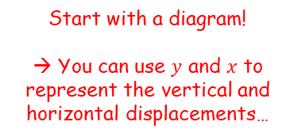


Projectiles
15ms⁻¹
Start with a diagram!
→ You can use $y$ and $x$ to represent the vertical and horizontal displacements…
You can use the constant acceleration formulae for a projectile moving in a vertical plane
A particle is projected horizontally with a velocity of 15ms⁻¹. Find:
The horizontal and vertical components of the displacement of the particle from the point of projection after 3 seconds
So we need to find how far the object has moved horizontally after 3 seconds, and how far it has moved vertically
The horizontal speed is constant…
$$y$$
$$x=45m$$
$$t=3s$$
$$x$$
The initial velocities in the horizontal and vertical directions are sometimes represented by $u_{x}$ and $u_{y}$ respectively…
$$u_{x}=15$$
$$u_{y}=0$$
$$(R→)$$
$$d=st$$
Sub in values – remember that $x$ is the horizontal distance
$$x=(15)(3)$$
Calculate
$$x=45m$$
6A

Slide 7







Projectiles
15ms⁻¹
Start with a diagram!
→ You can use $y$ and $x$ to represent the vertical and horizontal displacements…
You can use the constant acceleration formulae for a projectile moving in a vertical plane
A particle is projected horizontally with a velocity of 15ms⁻¹. Find:
The horizontal and vertical components of the displacement of the particle from the point of projection after 3 seconds
So we need to find how far the object has moved horizontally after 3 seconds, and how far it has moved vertically
We need to use a suvat equation to find the vertical distance, since the velocity is not constant…
$$y$$
$$x=45m$$
$$t=3s$$
$$y=44.1m$$
$$x$$
The initial velocities in the horizontal and vertical directions are sometimes represented by $u_{x}$ and $u_{y}$ respectively…
$$u_{x}=15$$
$$u_{y}=0$$
$$(R↓)$$
$$s=y$$
$$u=0$$
$$v=?$$
$$a=9.8$$
$$t=3$$
$$s=ut+\frac{1}{2}at^{2}$$
$$y=(0)(3)+\frac{1}{2}(9.8)({3)}^{2}$$
Sub in values
Calculate
$$y=44.1m$$
6A

Slide 8





Projectiles
15ms⁻¹
Start with a diagram!
→ You can use $y$ and $x$ to represent the vertical and horizontal displacements…
You can use the constant acceleration formulae for a projectile moving in a vertical plane
A particle is projected horizontally with a velocity of 15ms⁻¹. Find:
The horizontal and vertical components of the displacement of the particle from the point of projection after 3 seconds
b) Find the distance of the particle from its starting point after 3 seconds
We know that the particle has moved 45m horizontally, and 44.1m vertically downwards…
The total distance can be found using Pythagoras’ Theorem…
$$y$$
$$x=45m$$
$$t=3s$$
$$y=44.1m$$
$$x$$
$$45m$$
$$44.1m$$
$$Distance$$
$$d=\sqrt{{(45)}^{2}+{(44.1)}^{2}}$$
$=63m$ (2sf)
6A

Slide 9






Projectiles
$U$ ms⁻¹
Start with a diagram and label all the information you have…
You can use the constant acceleration formulae for a projectile moving in a vertical plane
A particle is projected horizontally with a speed of $U {ms}^{−1}$ from a point 122.5m above a horizontal plane. The particle hits the plane at a point which is at a horizontal distance of 90m away from the starting point.
Find the initial speed of the particle.
Remember that the horizontal velocity is constant…
Therefore:
$$122.5m$$
$$90m$$
We can use the vertical information to find when the particle hits the plane…
$$d=st$$
We know that the distance travelled is 90m
$$90=ut$$
So if we can find the time taken, we can then use it to find the initial velocity…
6A

Slide 10









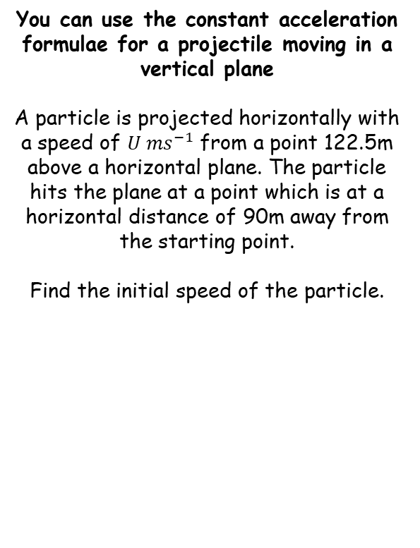


Projectiles
$U$ ms⁻¹
Start with a diagram and label all the information you have…
You can use the constant acceleration formulae for a projectile moving in a vertical plane
A particle is projected horizontally with a speed of $U {ms}^{−1}$ from a point 122.5m above a horizontal plane. The particle hits the plane at a point which is at a horizontal distance of 90m away from the starting point.
Find the initial speed of the particle.
$$122.5m$$
$$t=5$$
$$90m$$
We can use the vertical information to find when the particle hits the plane…
$$(R↓)$$
$$s=112.5$$
$$u=0$$
$$v=?$$
$$a=9.8$$
$$t=?$$
$$s=ut+\frac{1}{2}at^{2}$$
Sub in values
$$112.5=(0)(t)+\frac{1}{2}(9.8)t^{2}$$
Simplify right side
$$112.5=4.9t^{2}$$
Calculate, and take the positive value of $t$
$$5=t$$
6A

Slide 11





Projectiles
$U$ ms⁻¹
Start with a diagram and label all the information you have…
You can use the constant acceleration formulae for a projectile moving in a vertical plane
A particle is projected horizontally with a speed of $U {ms}^{−1}$ from a point 122.5m above a horizontal plane. The particle hits the plane at a point which is at a horizontal distance of 90m away from the starting point.
Find the initial speed of the particle.
$$122.5m$$
$$t=5$$
$$90m$$
Now we can resolve horizontally…
$$(R→)$$
$$d=st$$
We know that the distance travelled is 90m, after 5 seconds. The speed is $u$.
$$90=u(5)$$
Calculate
$$18=u$$
So the initial projection speed is 18ms⁻¹
6A

Slide 12
Teachings for
Exercise 6B

Slide 13




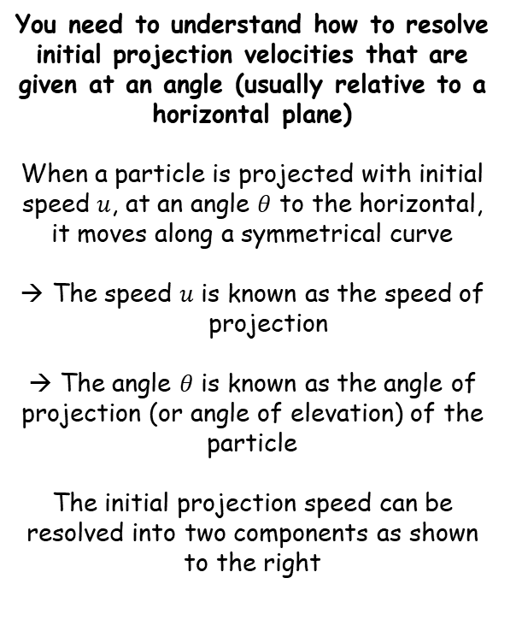
Projectiles
$$u ms^{−1}$$
You need to understand how to resolve initial projection velocities that are given at an angle (usually relative to a horizontal plane)
When a particle is projected with initial speed $u$, at an angle $θ$ to the horizontal, it moves along a symmetrical curve
The speed $u$ is known as the speed of projection
→ The angle $θ$ is known as the angle of projection (or angle of elevation) of the particle
The initial projection speed can be resolved into two components as shown to the right
θ
$$u ms^{−1}$$
$$uSinθ ms^{−1}$$
θ
$$uCosθ ms^{−1}$$
Any particle projected at an angle will have an initial horizontal and vertical speed, which you will usually need to resolve separately…
6B

Slide 14












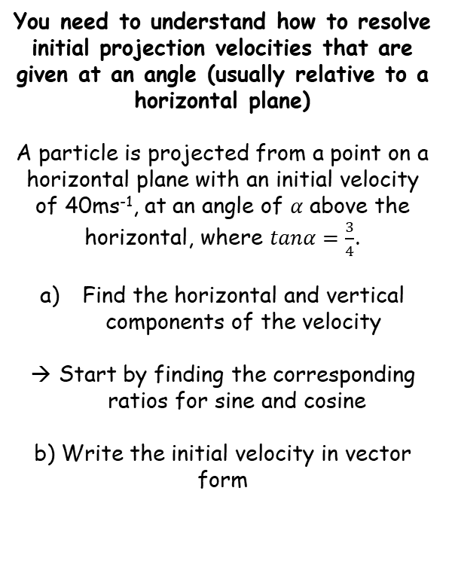


Projectiles
$$tanα=\frac{3}{4}$$
$$5$$
$$sinα=\frac{3}{5}$$
You need to understand how to resolve initial projection velocities that are given at an angle (usually relative to a horizontal plane)
A particle is projected from a point on a horizontal plane with an initial velocity of 40ms⁻¹, at an angle of $α$ above the horizontal, where $tanα=\frac{3}{4}$.
Find the horizontal and vertical components of the velocity
Start by finding the corresponding ratios for sine and cosine
b) Write the initial velocity in vector form
$$3$$
$$α$$
$$cosα=\frac{4}{5}$$
$$4$$
We can now use these ratio to split the initial velocity into its horizontal and vertical component parts
$${40 ms}^{−1}$$
$$40sinα {ms}^{−1}$$
$${24 ms}^{−1}$$
$$α$$
$$40cosα {ms}^{−1}$$
$${32 ms}^{−1}$$
Calculate the exact values using the ratio we found…
$$\left(32i+24j\right){ ms}^{−1}$$
6B

Slide 15








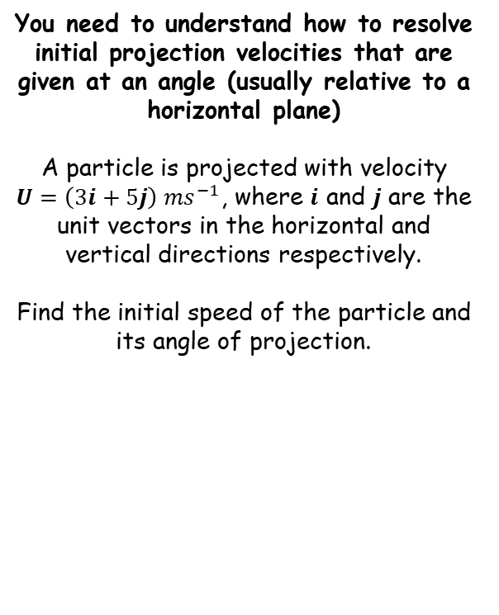


Projectiles
$$\sqrt{34}$$
You need to understand how to resolve initial projection velocities that are given at an angle (usually relative to a horizontal plane)
A particle is projected with velocity $U=\left(3i+5j\right) {ms}^{−1}$, where $i$ and $j$ are the unit vectors in the horizontal and vertical directions respectively.
Find the initial speed of the particle and its angle of projection.
$$5j$$
$$59^{°}$$
$$θ$$
$$3i$$
Initial speed – use Pythagoras’ Theorem…
$$=\sqrt{{(3)}^{2}+{(5)}^{2}}$$
$$=\sqrt{34}$$
Angle of projection – use tan…
$$={Tan}^{−1}\left(\frac{5}{3}\right)$$
$={59}^{°}$ (2sf)
So the initial projection is at speed $\sqrt{34} {ms}^{−1}$ at an angle of ${59}^{°}$ above the horizontal
6B

Slide 16
Teachings for
Exercise 6C

Slide 17












Projectiles
Start with a diagram!
28
You can use the constant acceleration formulae for a projectile moving in a vertical plane
A particle P is projected from a point O on a horizontal plane with speed 28ms⁻¹, and with angle of elevation 30°. After projection, the particle moves freely under gravity until it strikes the plane at a point A.
Find:
The greatest height above the plane reached by P
The time of flight of P
The distance OA
28sin30
30°
O
28cos30
A
The greatest height will be reached when the vertical velocity is 0 (as the particle stops moving up and starts moving down)
→ Resolve vertically and use SUVAT
$$(R↑)$$
$$s=?$$
$$u=28sin30$$
$$v=0$$
$$a=−9.8$$
$$t=?$$
$$v^{2}=u^{2}+2as$$
$$10m$$
Sub in values
$${(0)}^{2}={(28sin30)}^{2}+2(−9.8)(s)$$
Calculate terms
$$0=196−19.6s$$
Rearrange
$$19.6s=196$$
Calculate
$$s=10m$$
6C

Slide 18












Projectiles
Start with a diagram!
28
You can use the constant acceleration formulae for a projectile moving in a vertical plane
A particle P is projected from a point O on a horizontal plane with speed 28ms⁻¹, and with angle of elevation 30°. After projection, the particle moves freely under gravity until it strikes the plane at a point A.
Find:
The greatest height above the plane reached by P
The time of flight of P
The distance OA
28sin30
30°
O
28cos30
A
The time of flight of the particle will be when its vertical displacement is 0 (ie – it is at the same height it started at)
→ Resolve vertically and use SUVAT (again)
$$(R↑)$$
$$s=0$$
$$u=28sin30$$
$$v=?$$
$$a=−9.8$$
$$t=?$$
$$s=ut+\frac{1}{2}at^{2}$$
$$0=(28sin30)(t)+\frac{1}{2}(−9.8)(t^{2})$$
Sub in values
$$10m$$
Work out terms
$$2.9s$$
$$0=28tsin30−4.9t^{2}$$
Factorise
$$0=t(28sin30−4.9t)$$
Either part could be 0
The answer of 0 corresponds to the particle’s starting position. The value 2.9 is the time it takes to hit the ground again
$$t=0$$
$$or$$
$$28sin30−4.9t=0$$
Work out the second possibility
$$t=2.9$$
6C

Slide 19


Projectiles
Start with a diagram!
28
You can use the constant acceleration formulae for a projectile moving in a vertical plane
A particle P is projected from a point O on a horizontal plane with speed 28ms⁻¹, and with angle of elevation 30°. After projection, the particle moves freely under gravity until it strikes the plane at a point A.
Find:
The greatest height above the plane reached by P
The time of flight of P
The distance OA
28sin30
30°
O
28cos30
A
The distance OA will be based on the horizontal projection speed (which is constant)
→ We can use the time of flight calculated in part b)
$$Horizontal distance=Horizontal speed×time$$
$$Horizontal distance=28cos30×2.9$$
$$10m$$
$$Horizontal distance=69m (2sf)$$
$$2.9s$$
$$69m$$
6C

Slide 20












Projectiles
V
Start with a diagram!
You can use the constant acceleration formulae for a projectile moving in a vertical plane
A particle is projected from a point O with speed Vms⁻¹ at an angle of elevation θ, where tanθ = ⁴/₃. The point O is 42.5m above the horizontal plane. The particle strikes the plane 5 seconds after it is projected.
Show that V = 20ms⁻¹
Find the distance between O and A
Find the values of Sinθ and Cosθ first, by labelling a triangle where Tanθ = ⁴/₃ (That is, opposite = 4 and adjacent = 3)
$$Tanθ=\frac{4}{3}$$
Vsinθ
O
θ
$$Sinθ=\frac{4}{5}$$
Vcosθ
42.5m
$$Cosθ=\frac{3}{5}$$
A
Resolving vertically using the information given (taking upwards as positive)
→ The ball will be 42.5m lower after 5 seconds
$$(R↑)$$
$$s=−42.5$$
$$u=Vsinθ$$
$$v=?$$
$$a=−9.8$$
$$t=5$$
$$s=ut+\frac{1}{2}at^{2}$$
$$−42.5=(Vsinθ)(5)+\frac{1}{2}(−9.8)(5^{2})$$
Sub in values
Hyp
Use Pythagoras’ Theorem to find the missing side
→ Remember Sinθ = ^{opp}/_{hyp} and Cosθ = ^{adj}/_{hyp}
Calculate terms (use sinθ = ⁴/₅)
5
$$−42.5=4V−122.5$$
4
Opp
Add 122.5
3
$$80=4V$$
Divide by 4
Adj
$$20=V$$
6C

Slide 21


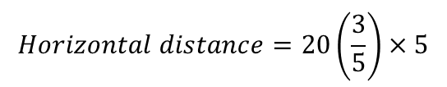
Projectiles
V
Start with a diagram!
You can use the constant acceleration formulae for a projectile moving in a vertical plane
A particle is projected from a point O with speed Vms⁻¹ at an angle of elevation θ, where tanθ = ⁴/₃. The point O is 42.5m above the horizontal plane. The particle strikes the plane 5 seconds after it is projected.
Show that V = 20ms⁻¹
Find the distance between O and A
$$Tanθ=\frac{4}{3}$$
Vsinθ
O
θ
$$Sinθ=\frac{4}{5}$$
Vcosθ
42.5m
$$Cosθ=\frac{3}{5}$$
60m
A
$$Horizontal distance=Horizontal speed×time$$
$$Horizontal distance=Vcosθ×5$$
Make sure you read the question – we want the distance OA, not just the horizontal distance travelled!
$$Horizontal distance=20\left(\frac{3}{5}\right)×5$$
$$Horizontal distance=60m$$
6C

Slide 22


Projectiles
V
Start with a diagram!
You can use the constant acceleration formulae for a projectile moving in a vertical plane
A particle is projected from a point O with speed Vms⁻¹ at an angle of elevation θ, where tanθ = ⁴/₃. The point O is 42.5m above the horizontal plane. The particle strikes the plane 5 seconds after it is projected.
Show that V = 20ms⁻¹
Find the distance between O and A
$$Tanθ=\frac{4}{3}$$
O
θ
$$Sinθ=\frac{4}{5}$$
42.5m
$$Cosθ=\frac{3}{5}$$
60m
A
Use Pythagoras’ Theorem to calculate the distance
$$\sqrt{{42.5}^{2}+{60}^{2}}$$
$=74m$(2sf)
6C

Slide 23













Projectiles
Start with a diagram!
You can use the constant acceleration formulae for a projectile moving in a vertical plane
A particle is projected from a point O with speed 35ms⁻¹ at an angle of elevation of 30°. The particle moves freely under gravity.
Find the length of time for which the particle is 15m or more above O
→ We want to find the times that the particle is exactly at 15m. There will be 2 of these, once as the particle is travelling up, and once as it is travelling down.
15m
35
35Sin30
30°
35Cos30
Resolving vertically, taking upwards as positive
$$(R↑)$$
$$s=15$$
$$u=35Sin30$$
$$v=?$$
$$a=−9.8$$
$$t=?$$
$$s=ut+\frac{1}{2}at^{2}$$
Sub in values
$$15=(35sin30)(t)+\frac{1}{2}(−9.8)(t^{2})$$
$$a=4.9$$
$$b=−35sin30$$
$$c=15$$
Work out each term
$$15=35tsin30−4.9t^{2}$$
Rearrange to a quadratic form
$$4.9t^{2}−35tsin30+15=0$$
This will be difficult to factorise so we should use the quadratic formula – hence we need a, b and c
6C

Slide 24



Projectiles
Start with a diagram!
You can use the constant acceleration formulae for a projectile moving in a vertical plane
A particle is projected from a point O with speed 35ms⁻¹ at an angle of elevation of 30°. The particle moves freely under gravity.
Find the length of time for which the particle is 15m or more above O
→ We want to find the times that the particle is exactly at 15m. There will be 2 of these, once as the particle is travelling up, and once as it is travelling down.
15m
35
35Sin30
30°
35Cos30
$$t=\frac{−b±\sqrt{b^{2}−4ac}}{2a}$$
$$t=\frac{35sin30±\sqrt{{(−35sin30)}^{2}−(4×4.9×15)}}{2(4.9)}$$
$$t=1.43 or 2.14 seconds (2dp)$$
$$a=4.9$$
$$b=−35sin30$$
$$c=15$$
The difference between these times will be the time spent above 15m
→ Subtract the smallest from the biggest
Time above 15m = 0.71 seconds
(remember to use exact answers)
6C

Slide 25












Projectiles
(5i + 8j)
You can use the constant acceleration formulae for a projectile moving in a vertical plane
A ball is struck by a racket at a point A which is 2m above horizontal ground. Immediately after being struck, the ball has velocity (5i + 8j) ms⁻¹, where i and j are unit vectors horizontally and vertically respectively.
After being struck, the ball travels freely under gravity until is strikes the ground at a point B, as shown. Find:
The greatest height above ground reached by the ball
The speed of the ball as it reaches B
The angle the velocity of the ball makes with the ground as the ball reaches B
8j
A
5i
2m
B
You can use the vectors in each direction as the initial velocities
→ Resolve vertically to find the greatest height
$$(R↑)$$
$$s=?$$
$$u=8$$
$$v=0$$
$$a=−9.8$$
$$t=?$$
$$v^{2}=u^{2}+2as$$
Sub in values
$${(0)}^{2}={(8)}^{2}+2(−9.8)s$$
$$s=5.3m$$
Work out terms
$$0=64−19.6s$$
Calculate s
$$s=3.3m$$
Careful – the ball starts at a height of 2m, so this must be added on!
$$s=5.3m$$
6C

Slide 26










Projectiles
(5i + 8j)
You can use the constant acceleration formulae for a projectile moving in a vertical plane
A ball is struck by a racket at a point A which is 2m above horizontal ground. Immediately after being struck, the ball has velocity (5i + 8j) ms⁻¹, where i and j are unit vectors horizontally and vertically respectively.
After being struck, the ball travels freely under gravity until is strikes the ground at a point B, as shown. Find:
The greatest height above ground reached by the ball
The speed of the ball as it reaches B
The angle the velocity of the ball makes with the ground as the ball reaches B
8j
A
5i
2m
B
As the ball strikes B, its velocity will have both a horizontal and vertical component
The horizontal speed is constant (5) so we do not need to calculate this
The vertical speed however will vary as the ball travels so we need to work this out…
At B the ball has travelled 2m down – resolve vertically again, taking downwards as the positive direction
$$(R↓)$$
$$s=2$$
$$u=−8$$
$v=$?
$$a=9.8$$
$$t=?$$
$$s=5.3m$$
$$v^{2}=u^{2}+2as$$
Sub in values
$$v^{2}={(−8)}^{2}+2(9.8)(2)$$
Work out right side
$$v^{2}=103.2$$
$$v=10.2ms^{−1}$$
Square root
So as it strikes B, the ball has a velocity of 10.2ms⁻¹ downwards
6C

Slide 27



Projectiles
(5i + 8j)
You can use the constant acceleration formulae for a projectile moving in a vertical plane
A ball is struck by a racket at a point A which is 2m above horizontal ground. Immediately after being struck, the ball has velocity (5i + 8j) ms⁻¹, where i and j are unit vectors horizontally and vertically respectively.
After being struck, the ball travels freely under gravity until is strikes the ground at a point B, as shown. Find:
The greatest height above ground reached by the ball
The speed of the ball as it reaches B
The angle the velocity of the ball makes with the ground as the ball reaches B
8j
A
5i
2m
B
As the ball strikes B, its velocity will have both a horizontal and vertical component
The horizontal speed is constant (5) so we do not need to calculate this
The vertical speed however will vary as the ball travels so we need to work this out…
At B the ball has travelled 2m down – resolve vertically again, taking downwards as the positive direction
5
$$(R↓)$$
You can just use Pythagoras to work out the overall speed!
$$s=5.3m$$
10.2
$$=\sqrt{5^{2}+{10.2}^{2}}$$
$$=11ms^{−1}$$
$$=11ms^{−1} (2sf)$$
B
6C

Slide 28







Projectiles
(5i + 8j)
You can use the constant acceleration formulae for a projectile moving in a vertical plane
A ball is struck by a racket at a point A which is 2m above horizontal ground. Immediately after being struck, the ball has velocity (5i + 8j) ms⁻¹, where i and j are unit vectors horizontally and vertically respectively.
After being struck, the ball travels freely under gravity until is strikes the ground at a point B, as shown. Find:
The greatest height above ground reached by the ball
The speed of the ball as it reaches B
The angle the velocity of the ball makes with the ground as the ball reaches B
8j
A
5i
2m
B
We can use the same diagram to calculate the angle between the velocity and the ground…
$$Tanθ=\frac{Opp}{Adj}$$
5
Sub in values
$$Tanθ=\frac{5}{10.2}$$
26.2°
θ
10.2
Calculate
63.8°
$$s=5.3m$$
$$Tanθ=0.49$$
B
$$=11ms^{−1}$$
Inverse Tan
$$θ=26.2°$$
Remember to work out the actual angle between the velocity and θ
→ (Subtract θ from 90$°$)
$$θ=63.8°$$
$$=63.8°$$
6C

Slide 29
Teachings for
Exercise 6D

Slide 30





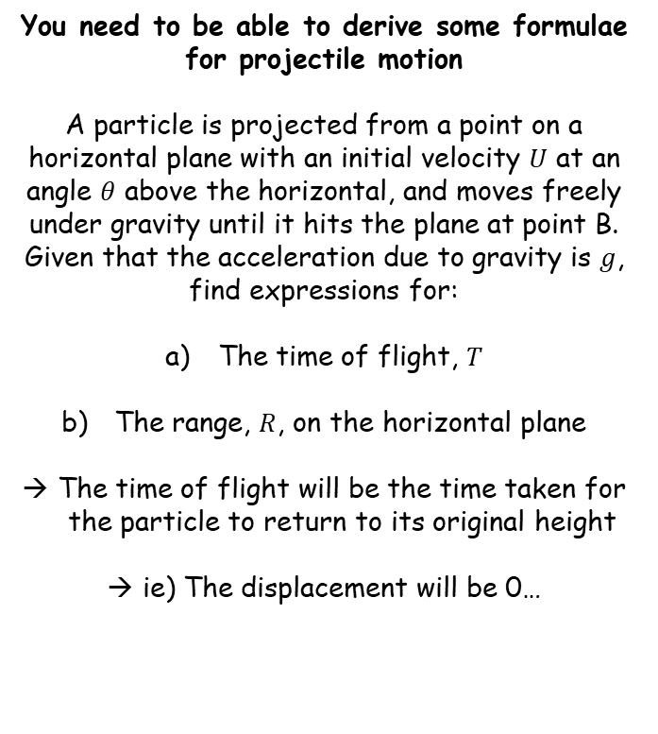








Projectiles
$$U$$
You need to be able to derive some formulae for projectile motion
A particle is projected from a point on a horizontal plane with an initial velocity $U$ at an angle $θ$ above the horizontal, and moves freely under gravity until it hits the plane at point B. Given that the acceleration due to gravity is $g$, find expressions for:
The time of flight, $T$
The range, $R$, on the horizontal plane
The time of flight will be the time taken for the particle to return to its original height
ie) The displacement will be 0…
$$Usinθ$$
θ
$$Ucosθ$$
Resolving vertically..
$$(R↑)$$
$$s=0$$
$$u=Usinθ$$
$$v=?$$
$$a=−g$$
$$t=T$$
$$s=ut+\frac{1}{2}{at}^{2}$$
$$0=(Usinθ)(T)+\frac{1}{2}{(−g)(T)}^{2}$$
Sub in values
$$0=UTsinθ−\frac{1}{2}gT^{2}$$
Simplify
Factorise
$$0=T\left(Usinθ−\frac{1}{2}gT\right)$$
Either $T=0$ (at the start of the motion), or the part inside the bracket is 0
6D

Slide 31








Projectiles
Time of flight on a horizontal plane
$$T=\frac{2Usinθ}{g}$$
$$U$$
You need to be able to derive some formulae for projectile motion
A particle is projected from a point on a horizontal plane with an initial velocity $U$ at an angle $θ$ above the horizontal, and moves freely under gravity until it hits the plane at point B. Given that the acceleration due to gravity is $g$, find expressions for:
The time of flight, $T$
The range, $R$, on the horizontal plane
The time of flight will be the time taken for the particle to return to its original height
ie) The displacement will be 0…
$$Usinθ$$
θ
$$Ucosθ$$
$$0=T\left(Usinθ−\frac{1}{2}gT\right)$$
The part inside the bracket is 0
$$0=Usinθ−\frac{1}{2}gT$$
Add $\frac{1}{2}gt$
$$\frac{1}{2}gT=Usinθ$$
Multiply by 2
$$gT=2Usinθ$$
Divide by $g$
$$T=\frac{2Usinθ}{g}$$
6D

Slide 32


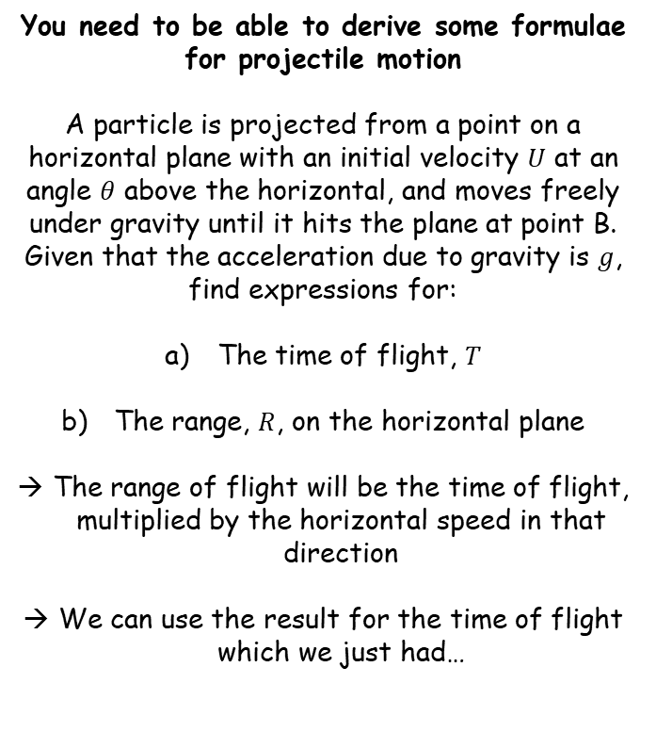



Projectiles
Time of flight on a horizontal plane
$$T=\frac{2Usinθ}{g}$$
Range of flight on a horizontal plane
$$T=\frac{U^{2}sin2θ}{g}$$
$$U$$
You need to be able to derive some formulae for projectile motion
A particle is projected from a point on a horizontal plane with an initial velocity $U$ at an angle $θ$ above the horizontal, and moves freely under gravity until it hits the plane at point B. Given that the acceleration due to gravity is $g$, find expressions for:
The time of flight, $T$
The range, $R$, on the horizontal plane
The range of flight will be the time of flight, multiplied by the horizontal speed in that direction
We can use the result for the time of flight which we just had…
$$Usinθ$$
θ
$$Ucosθ$$
$$Range=Horizontal speed×Time of flight$$
$$Range=Ucosθ×\frac{2Usinθ}{g}$$
Combine
$$Range=\frac{2U^{2}sinθcosθ}{g}$$
Use $Sin2θ=2sinθcosθ$
$$Range=\frac{U^{2}sin2θ}{g}$$
6D

Slide 33














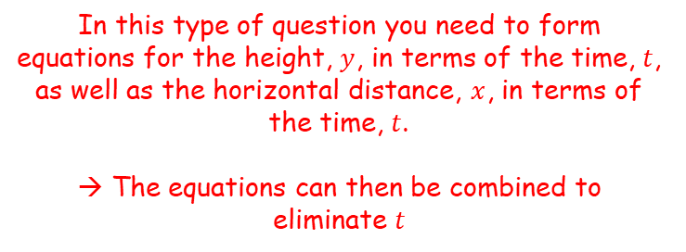

Projectiles
Time of flight on a horizontal plane
$$T=\frac{2Usinθ}{g}$$
Range of flight on a horizontal plane
$$T=\frac{U^{2}sin2θ}{g}$$
You need to be able to derive some formulae for projectile motion
A particle is projected from a point with speed $u$ and an angle of elevation $θ$, and moves freely under gravity. When the particle has moved a horizontal distance $x$, its height above the point of projection is $y$.
Show that:
u
$$uSinθ$$
$$θ$$
$$uCosθ$$
Finding the height in terms of t
Resolving vertically (upwards as positive)
Use g to represent acceleration and y to represent the height above the point of projection
$$(R↑)$$
$$y=xtanθ−\frac{gx^{2}}{2u^{2}}(1+tan^{2}θ)$$
$$s=y$$
$$u=usinθ$$
$$v=?$$
$$a=−g$$
$$t=t$$
In this type of question you need to form equations for the height, $y$, in terms of the time, $t$, as well as the horizontal distance, $x$, in terms of the time, $t$.
→ The equations can then be combined to eliminate $t$
$$s=ut+\frac{1}{2}at^{2}$$
Sub in values from SUVAT
$$y=(usinθ)(t)+\frac{1}{2}(−g)(t^{2})$$
‘Tidy up’
$$y=utsinθ−\frac{1}{2}gt^{2}$$
$$y=utsinθ−\frac{1}{2}gt^{2}$$
We now have an expression for the height in terms of u, t and θ
6D

Slide 34






Projectiles
Time of flight on a horizontal plane
$$T=\frac{2Usinθ}{g}$$
Range of flight on a horizontal plane
$$T=\frac{U^{2}sin2θ}{g}$$
You need to be able to derive some formulae for projectile motion
A particle is projected from a point with speed $u$ and an angle of elevation $θ$, and moves freely under gravity. When the particle has moved a horizontal distance $x$, its height above the point of projection is $y$.
Show that:
u
$$uSinθ$$
$$θ$$
$$uCosθ$$
Finding the horizontal distance in terms of t
$$y=xtanθ−\frac{gx^{2}}{2u^{2}}(1+tan^{2}θ)$$
$$Horizontal distance=Horizontal speed×time$$
$$x=ucosθ×t$$
Sub in values (remember x is to be used to represent the horizontal distance)
In this type of question you need to form equations for the height, $y$, in terms of the time, $t$, as well as the horizontal distance, $x$, in terms of the time, $t$.
→ The equations can then be combined to eliminate $t$
$$x=utcosθ$$
$$y=utsinθ−\frac{1}{2}gt^{2}$$
$$x=utcosθ$$
6D

Slide 35
















Projectiles
Time of flight on a horizontal plane
$$T=\frac{2Usinθ}{g}$$
Divide by cos²θ
$$sin^{2}θ+cos^{2}θ≡1$$
Range of flight on a horizontal plane
$$T=\frac{U^{2}sin2θ}{g}$$
$$tan^{2}θ+1≡sec^{2}θ$$
You need to be able to derive some formulae for projectile motion
A particle is projected from a point with speed $u$ and an angle of elevation $θ$, and moves freely under gravity. When the particle has moved a horizontal distance $x$, its height above the point of projection is $y$.
Show that:
$$y=utsinθ−\frac{1}{2}gt^{2}$$
$$x=utcosθ$$
Divide by ucosθ
$$\frac{x}{ucosθ}=t$$
$$y=utsinθ−\frac{1}{2}gt^{2}$$
Replace t with the expression above
$$y=u\left(\frac{x}{ucosθ}\right)sinθ$$
$$−\frac{1}{2}g{\left(\frac{x}{ucosθ}\right)}^{2}$$
$$y=xtanθ−\frac{gx^{2}}{2u^{2}}(1+tan^{2}θ)$$
Group the first set of terms, square the bracket
Now we have equations for $y$ and $x$.
The final answer we want has no ‘$t$’ terms, so this is an indication that you have to eliminate $t$ from the equations
The final answer is written as ‘$y =$‘, so it looks like we should rearrange the ‘$x$’ equation and substitute it into the ‘$y$’ equation
$$y=\frac{uxsinθ}{ucosθ}$$
$$− \frac{1}{2}g\left(\frac{x^{2}}{u^{2}cos^{2}θ}\right)$$
Cancel u’s on the first term. ^{Sin}/_{Cos} = Tan
$$− \frac{gx^{2}}{2u^{2}}\left(\frac{1}{cos^{2}θ}\right)$$
Group terms except for Cos on the second
$$y=xtanθ$$
1/cos = sec
$$y=xtanθ$$
$$− \frac{gx^{2}}{2u^{2}}sec^{2}θ$$
Use the trig identity above to replace sec
$$y=xtanθ$$
$$− \frac{gx^{2}}{2u^{2}}(tan^{2}θ+1)$$
6D

Slide 36










Projectiles
Time of flight on a horizontal plane
$$T=\frac{2Usinθ}{g}$$
$$y=xtanθ−\frac{gx^{2}}{2u^{2}}(1+tan^{2}θ)$$
Range of flight on a horizontal plane
$$T=\frac{U^{2}sin2θ}{g}$$
You need to be able to derive some formulae for projectile motion
A particle is projected from a point A on a horizontal plane, with initial speed 28ms⁻¹ and an angle of elevation θ. The particle passes through a point B, which is 8m above the plane and a horizontal distance of 32m from A
Find the two possible values of θ, giving your answers to the nearest degree.
(Use the formula we have just calculated)
$$y=xtanθ−\frac{gx^{2}}{2u^{2}}(1+tan^{2}θ)$$
Sub in the values we know
$$8=32tanθ−\frac{9.8{(32)}^{2}}{2{(28)}^{2}}(1+tan^{2}θ)$$
Calculate the large fraction
$$8=32tanθ−6.4(1+tan^{2}θ)$$
Multiply out the bracket
$$8=32tanθ−6.4+6.4tan^{2}θ$$
Rearrange to a quadratic form
$$6.4tan^{2}θ+32tanθ−14.4=0$$
You can solve this like a quadratic by using the quadratic formula
$$y=xtanθ−\frac{gx^{2}}{2u^{2}}(1+tan^{2}θ)$$
$$a=6.4$$
$$b=32$$
$$c=−14.4$$
6D

Slide 37











Projectiles
Time of flight on a horizontal plane
$$T=\frac{2Usinθ}{g}$$
Range of flight on a horizontal plane
$$T=\frac{U^{2}sin2θ}{g}$$
You need to be able to derive some formulae for projectile motion
A particle is projected from a point A on a horizontal plane, with initial speed 28ms⁻¹ and an angle of elevation θ. The particle passes through a point B, which is 8m above the plane and a horizontal distance of 32m from A
Find the two possible values of θ, giving your answers to the nearest degree.
(Use the formula we have just calculated)
$$6.4tan^{2}θ+32tanθ−14.4=0$$
$$a=6.4$$
$$b=32$$
$$c=−14.4$$
$$tanθ=\frac{−b±\sqrt{b^{2}−4ac}}{2a}$$
$$tanθ=\frac{−32±\sqrt{{32}^{2}−(4×6.4×−14.4)}}{2(6.4)}$$
Sub in values
Calculate each possibility
$$tanθ=0.5$$
$$or$$
$$tanθ=4.5$$
Use inverse Tan (and round answers)
$$θ=27°$$
$$or$$
$$θ=77°$$
There will be two possibilities here:
$$y=xtanθ−\frac{gx^{2}}{2u^{2}}(1+tan^{2}θ)$$
If a projectile passes through point B, there are two possible angles it could have been launched through
B
A
6D

Slide 38




Projectiles
Time of flight on a horizontal plane
Time to reach greatest height
Range of flight on a horizontal plane
Equation of the trajectory
$$T=\frac{2Usinθ}{g}$$
$$T=\frac{Usinθ}{g}$$
$$T=\frac{U^{2}sin2θ}{g}$$
$$y=xtanθ−\frac{gx^{2}}{2u^{2}}(1+tan^{2}θ)$$
You need to be able to derive formula from algebraic situations
You are not given these in the booklet, but can use them in problem solving if you remember them
However, it is easy to get them mixed up, so it is generally recommended that you solve non-algebraic problems using the techniques that you have already learned this chapter
6D

